Slide 1
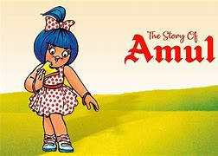
Dr.Lankapalli Bullayya Degree & PG College
Team Leader ( P.Anil Kumar)
1.P.Anil kumar
2.P.Anusha
3.P.Keerthi
4.P.Karthik Surya
5.P.Thanuja

Slide 2
Index
Part-1: Brand study, Competitor Analysis & Buyer’s/Audience’s Persona
Part-2: SEO & Keyword Research
Part-3: Content Ideas and Marketing Strategies
Part-4: Content Creation And Curation (Post creations, Designs/Video Editing, Ad Campaigns over Media and Email Ideation and Creation)

Slide 3
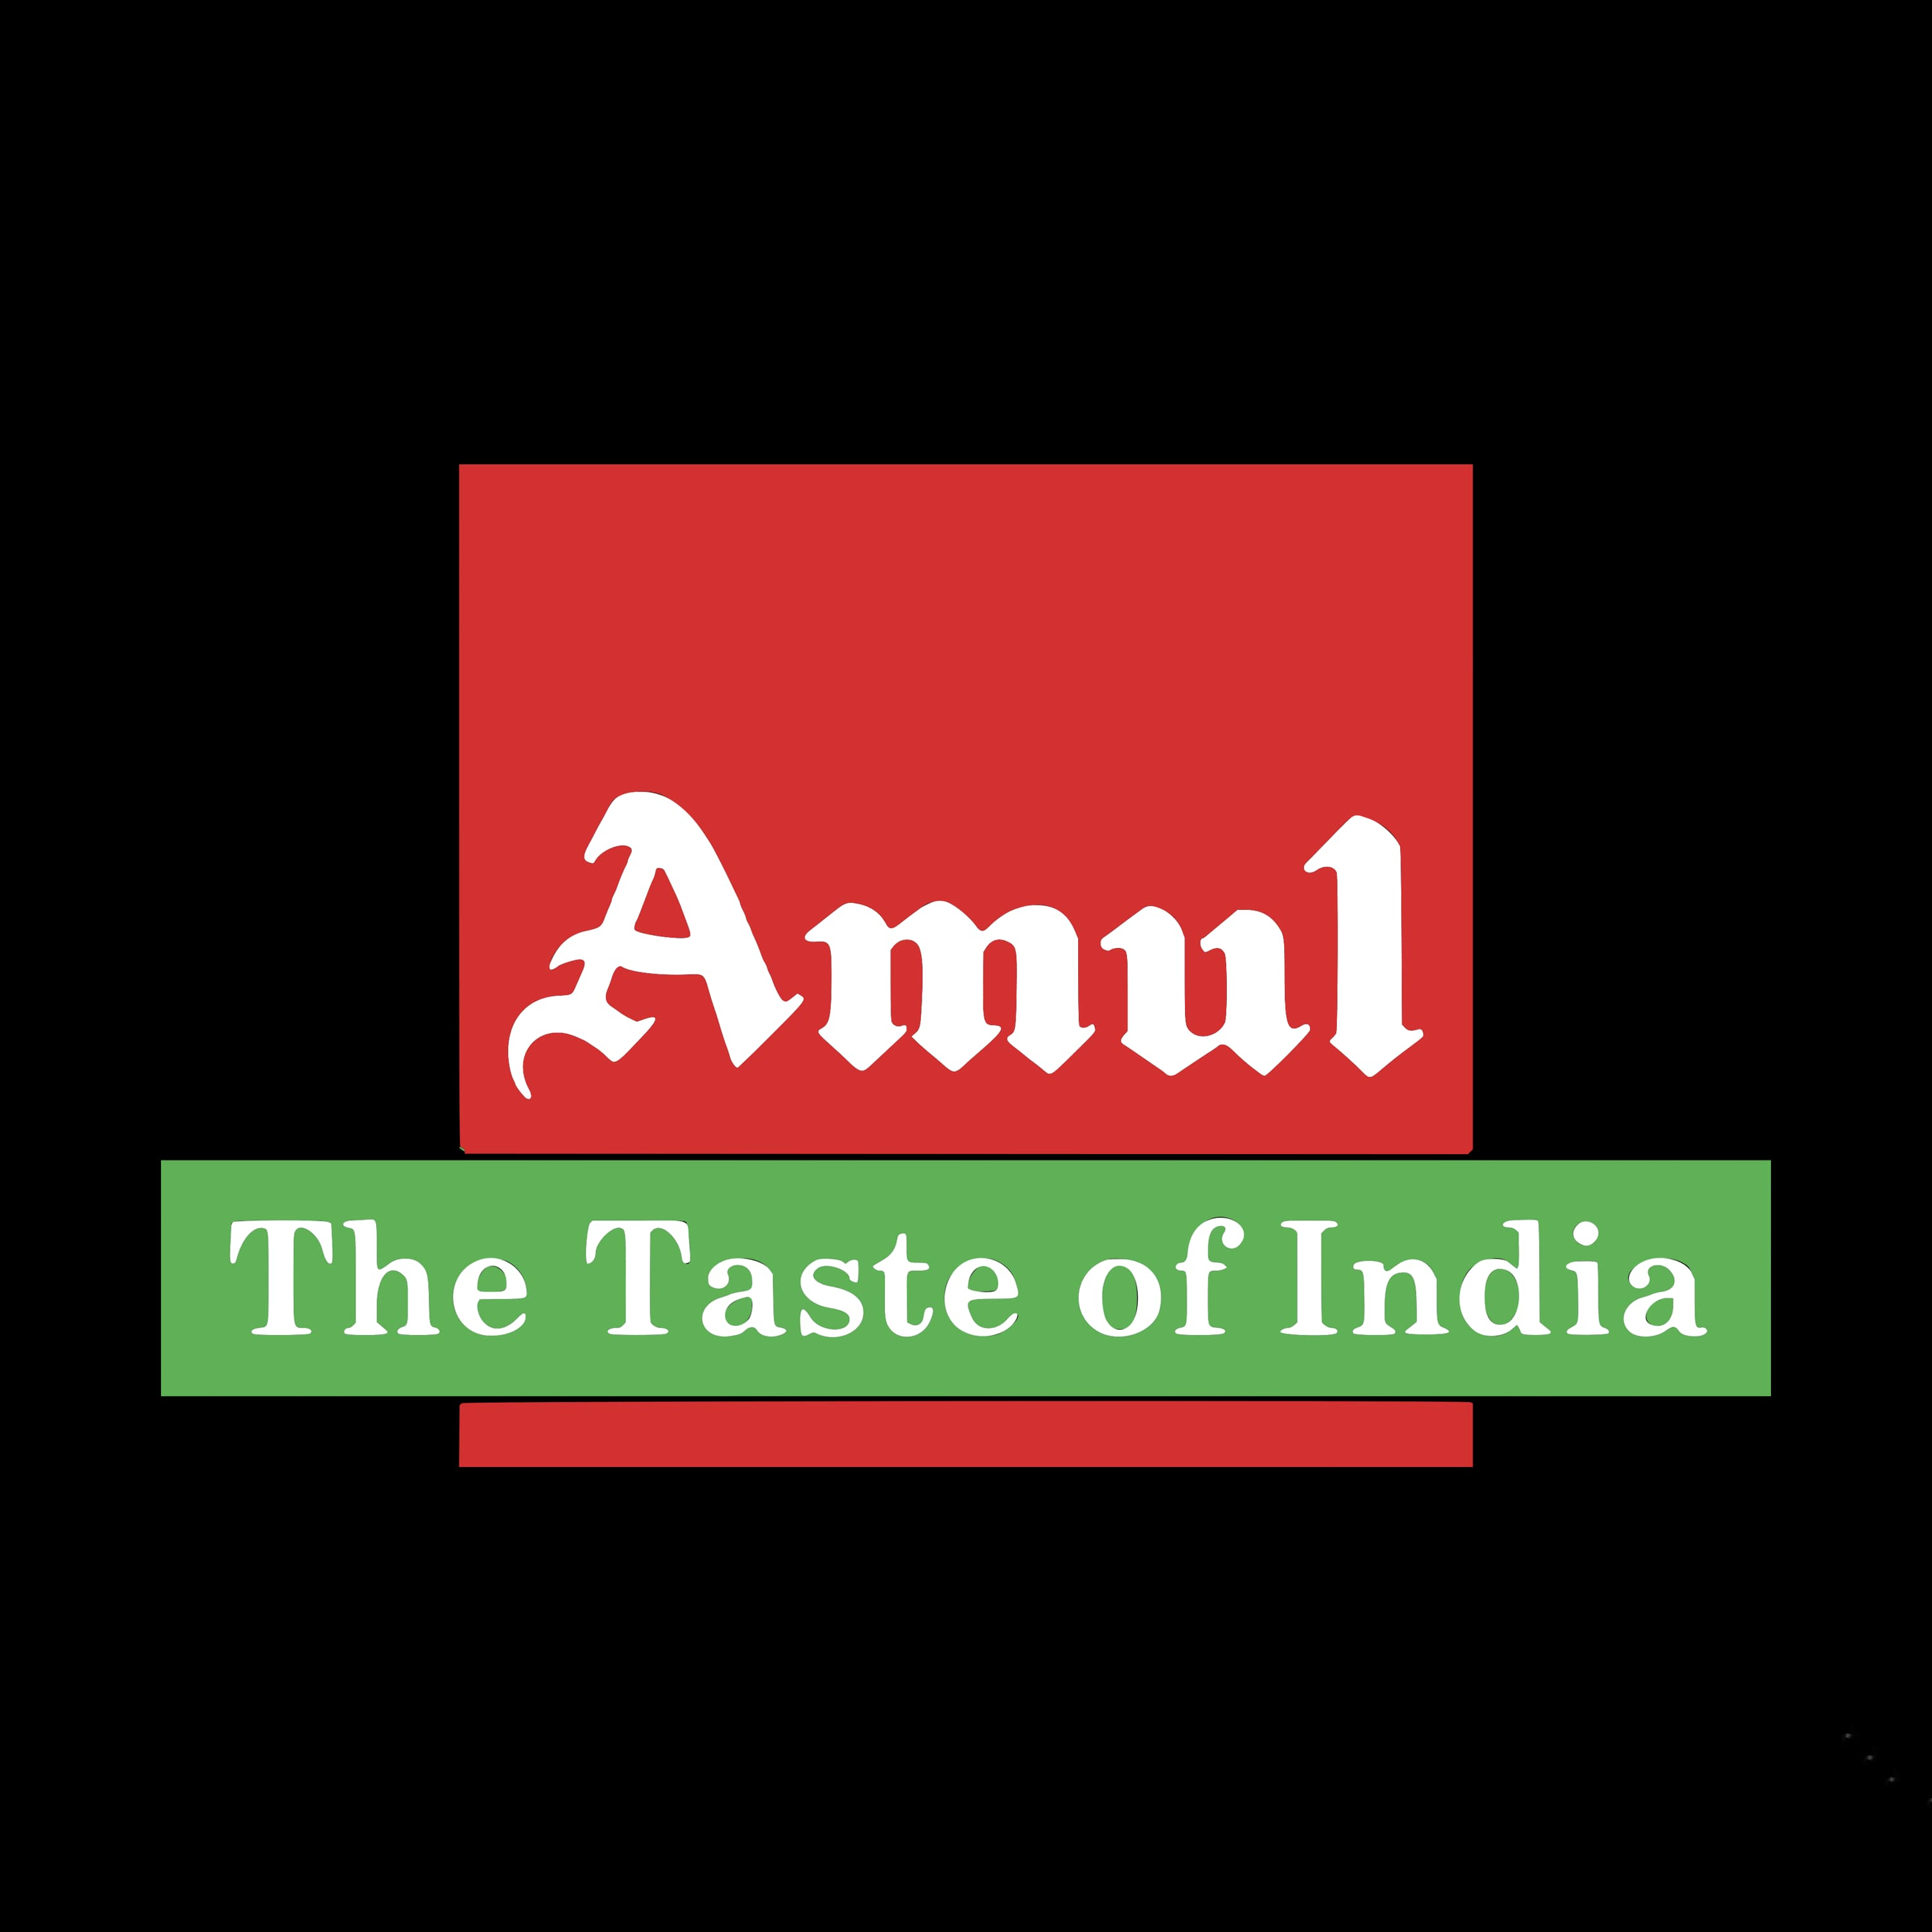
Part-1 Brand study, Competitor Analysis & Buyer’s/Audience’s Persona
Research Brand:
Mission/Values: To satisfy the taste and nutritional requirements for the custumer of the word through excellence the marketing committed to offer quality product that provides best value for more. Give customers a good, fair deal. Great customer relationships take time.
USP: The main USP of the Amul brand is its low pricing. It hits the transnationals by reducing the prices on its product portfolio
Analyze Brand Tone and Identity: Amul’s brand identity is centred around the iconic “Amul girl,” a young girl in a polka-dot dress who has become synonymous with the brand.

Slide 4
Brand study (Mission/Values & USP)
Mission/Values:
Amul’s added products contribute to farmers’ livelihoods and provide value for money to consumers. They aim to become the biggest dairy brand globally, focusing on competitive pricing and strong distribution.
Clean: Amul is one of the prominent brands in terms of dairy product such fluid is a rich source of protein.
Kind: Amul flavoured milk more details, Amul lassi more details, Amul Masti Buttermilk More details ,Pouch Butter Milk More details.
Effective: One of the remarkable aspects of Amul’s success is its impact on rural empowerment. The dairy production process and ensuring a fair price the economic status of countless rural household.
Unique Selling Proposition (USP) Analysis: The main USP of the Amul brand is its low pricing. It hits the transnationals by reducing the prices on its product portfolio.
Notes:
ka

Slide 5
Brand study (Brand Tone & KPI)
Brand Tone
Amul ‘s tone, however, is always somewhat easygoing and friendly. They instill their brand products by creation their own slang word. The brand’s commitment to providing authentic and delicious dairy products, but also serves as a powerful statement of cultural pride.
Simple Amul KPLs may include:
Sales growth: In a statement, the Gujarat Co-operative Milk Marketing Federation Ltd (GCMMF) said it has registered a provisional turnover of Rs 55,055 crore for the financial year 2022-23.
Customer Satisfaction: The respondents are frequently purchased the brand Amul Ice cream. 40% of the respondents are satisfied in price satisfied in quality 30% of the respondents are satisfied in package.
Brand Awareness: Amul is not just a brand; it’s a movement that represents the empowerment of Indian farmers and the democratization of the dairy industry.
Market Share: We have the largest manufacturers and brand of cheese in the country. Our market share is more than 70 in the range of 70-75%, slightiy less than butter which is about 85%.

Slide 6
Buyer/Audience Persona
Name: Chandra Sekhar
Age: 25
Gender: male
Occupation: Teacher
Income: 4-5 LPA
Psychographics:
Value: Appreciation of quality, cultural connections, creative and Ethical Consumption.
Interests: Loves to try new snacks, especially those with unique flavours.
Personality: Gravites around new restaurents that offer culinary experiences and actively engages with food content social media platforms.
Behavior:
Shopping habits: Quality over quality, Adventurous tastes, seasonal and Eco- Consciousness.
Social media usage: Active in social media with food content like following food bloggers , chefs and food brands to stay updated on the latest food trends.
Goals:
As a busy professional, she seeks brands that offer easy access to their products through online platforms or local stores, saving her time and effort in purchasing.
Challenges:
Managing limitations due to health, allergic and ethics.
Minimizing waste while experiencing new recipes.
findings genuine experiences in midst of global food trends.
Accessing exotic ingredients or specially foods.
Balancing expenses with dictary exploration.

Slide 7
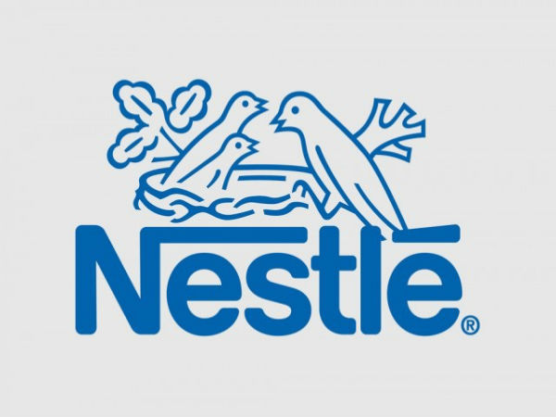

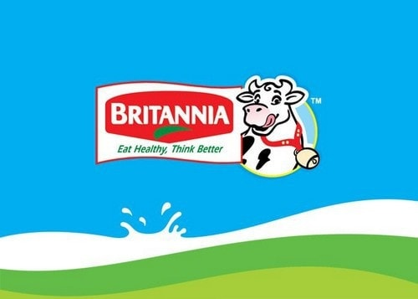
Part 1: Brand study, Competitor Analysis & Buyer’s/Audience’s Persona
Competitor Analysis: Analyzing Amul’s competitor provides valuable insights into the dairy industry landscape. Here’s a brief competitor analysis each competitor brings unique strengths and strategies to the table, such as product innovation, marketing prowess, distribution networks, or brand loyalty. Can provide a comprehensive understanding of the competitive landscape for Amul.
Nestle India: Nestle is a major competitor with a diverse product portfolio
Including dairy products like milk, yogurt, and cheese. They focus on innovation
Quality, and health-conscious products.
Mother Dairy: Operating primarily in North India, Mother Dairy is known for its
Wide range of dairy products, including milk, ice cream, and packaged dairy items.
They have a strong presence in urban markets.
Britannia Industries: Britannia is a key player in the dairy segment with products
like cheese, Milk, and dairy-based snacks. They focus on innovation and catering to
changing consumer prefences

Slide 8
Competitor 1: Nestle
USP: Nestle offers a wide range of food and beverage products, including dairy, coffee, baby food, confectionery, and health supplements. Consumers often associate Nestle with reliability and high standards. Nutrition and health in its products that align with consumer trends towards wellness, convenience, and sustainability it maintain a competitive edge in the food and beverage industry globally.
Online Communication:
Nestle maintains active profiles on major social media platforms
Like Facebook, Twitter, Instagram, Linkedln, and YouTube. This
Content aims to educate consumers, establish Nestle as an authority
In the food industry, and create meaningful interactions with
Followers respond promptly to customer inquiries, resolve issues,
And maintain a positive brand image through effective
Communication.

Slide 9
Swot
Strengths
Nestle is recognized globally for its trusted brands, quality products, and commitment to nutrition,
health, and wellness. The company’s strong brand equity instills consumer confidence and loyalty.
Innovation and R&D Nestle invests significantly in research and development, driving innovation in product formulations, packaging, sustainability, and health-focused initiatives.
Efficient Supply Chain well-established network ensuring timely delivery. Effective Marketing and communication strategies.
Weakness
Overreliance on mature markets dependence on saturated markets for revenue growth.
Environmental Concerns criticisms related to environmental impact and sustainability practices.
Legal and regulatory challenges facing legal and regulatory hurdles in various markets.

Slide 10
Swot
Opportunities
E-commerce growth leverage digital platforms to enchance online sales and engage with customer directly, especially considering the ongoing trend towards online shopping
Emerging Markets focus on expanding in emerging markets where there is a rising middle class and increasing disposable incomes, providing a significant growth opportunity.
Innovation and research continue investing in R&D to innovate new products, improve existing ones, and stay ahead of marking trends and consumer preferences.
Threats
Competition intense competition from both global giants and local players in various product categories could lead to market share erosion and pricing pressures.
Regulatory challenges increasingly stringent regulations related to food safety, labeling, advertising, and environmental sustainability may impact operations and increase compliance costs.
Digital disruption from digital platforms, e-commerce channels, and direct-to-consumer modals could challenge traditional distribution networks and marketing strategies.

Slide 11
Competitor 2: Mother Dairy
USP
Quality assurance Mother Dairy emphasizes its commitment to providing high-quality dairy products that meet stringent standards and are produced using advanced technologies and processes. Farm freshness the brand highlights the freshness of its products, often sourcing milk and other dairy ingredients directly from farms to ensure maximun freshness and nutritional value.
Online Communication:
Social media presence Mother Dairy maintains active profiles on
Popular social media platforms like Facebook, Instagram, Twitter, and
Linkedln. Website Mother Dairy’s official website serves as a central
Hub for information about its products, company values, sustainability efforts, and more. Email marketing
Mother Dairy uses email marketing campaigns to reach out to subscribers with special promotions, new product launches, seasonal offers, and relevant content like recipes or health articles.

Slide 12
Swot
Strengths
Strong brand reputation Mother Dairy has a longstanding reputation for providing high-quality dairy products earning trust and loyalty among consumer.
Wide product range the brand offers a diverse range of dairy products including milk, yogurt, ice cream , butter, cheese, and more, catering to different consumer consumer preferences.
Affordable pricing while maintaining quality, Mother Dairy offers its products at competitive prices, making them accessible to a broad consumer base.
Weakness
Dependence on dairy Mother dairy’s heavy reliance on dairy products makes it vulnerable to fluctuations in milk prices, supply chain disruptions, and changing consumer preferences.
Limited product diversification while known for dairy products, Mother dairy’s limited diversification into non-dairy alternatives or other food categories may limit growth opportunities.
Seasonal demand some products like ice cream may experience seasonal demand, requiring effective marketing strategies to boost sales during off-peak periods.

Slide 13
Swot
Opportunities
Health and wellness trends leverage the growing demand for healthy and nutritious food by expanding the range of organic, plant-based, and functional dairy products.
Diversification explore opportunities to diversify into non-dairy alternatives like plant-based milk, vegan cheese, and dairy –free desserts to cater to changing consumer preferences.
Digital transformation embrace digital technologies for online sales, marketing campaigns, data analytics, and customer engagement to enhance the brand’s digital presence and reach.
Threats
Supply chain disruptions vulnerability to supply chain disruptions such as fluctuations in milk supply, transportation issues, or disruptions in raw material availability.
Changing consumer preferences shifts in consumer preferences towards plant-based alternatives, organic products could require adaptation and product diversification.
Regulatory changes evolving regulations related to food safety, labelling, environmental standards, and import/export policies may pose compliance challenges and impact operations.

Slide 14
Competitor 3: Britannia
USP
Britannia’s unique selling proposition (USP) lies in its wide range of quality food products, focusing on taste, nutrition, and convenience. They often emphasize their commitment to using high-quality ingredients, maintaining stringent quality control standards, and catering to diverse consumer preferences with innovative flavors and packaging.
Online Communication:
Social media Britannia maintains active profiles on platforms like Facebook,
Twitter, Instagram, and Linkedln. They use these platforms to share product
Updates, promotions, recipes, and engage with customers through comments,
Messages and contests. It also includes features like online shopping, where
Customers can browse and purchase Britannia products. Britannia may have mobile apps for specific purposes, such as recipe apps or loyalty programs, providing additional value and convenience to their
Customers.

Slide 15
Swot
Strengths
Strong brand recognition and heritage diverse product range catering to varied preferences.
The strengths collectively contribute to Britannia’s market leadership, customer trust , and sustained growth in the food industry.
Effective marketing and advertising strategies commitment to corporate social responsibility financial stability and consistent growth.
Weakness
Limited presence in international markets compared to same competitors vulnerability to market fluctuations in raw material prices.
Potential dependency on traditional distribution channels amid evolving consumer preferences for
online shopping.
Rick of consumer perception shifts due to health and wellness trends impacting certain product categories.

Slide 16
Swot
Opportunities
Expansion into emerging markets with growing consumer demand for packaged food.
Diversification into new product categories or healthier alternatives to acter to changing consumer preferences.
Strategic partnerships or acquisitions to strengthen market presence and capabilities.
Threats
Intense competition from both domestic and global food companies price volatility of key raw materials affecting production costs.
Changing consumer preferences towards healthier and organic alternatives regulatory changes impacting food labelling, advertising and product formulations
Disruptions in supply chain logistics due to external factors like natural disasters or geopolitical events.

Slide 17
Part 2: SEO & Keyword Research
SEO Audit: Do an SEO audit of the brands website
Keyword Research: Keyword research for Amul would involve identifying relevant keywords related to their products, services, industry, and target audience. Understand Amul’s Offerings, Identify Seed Keywords, Expand with Keyword Tools, Competitor Analysis, Consider User Intent, Local Keywords (if applicable), Evaluate Keyword Difficulty and Search Volume, Long-Tail Keywords, Brand-specific Keyword, Refine and Organize
On page Optimization: Meta Tag optimization & Content optimization
Implementing these on-page optimization strategies can enhance the overall user experience, improve search engine rankings, and drive organic traffic to Amul’s website.
Social sharing integration include social sharing buttons to encourage user to share content on social media platform, increasing visibility and angagement.

Slide 18
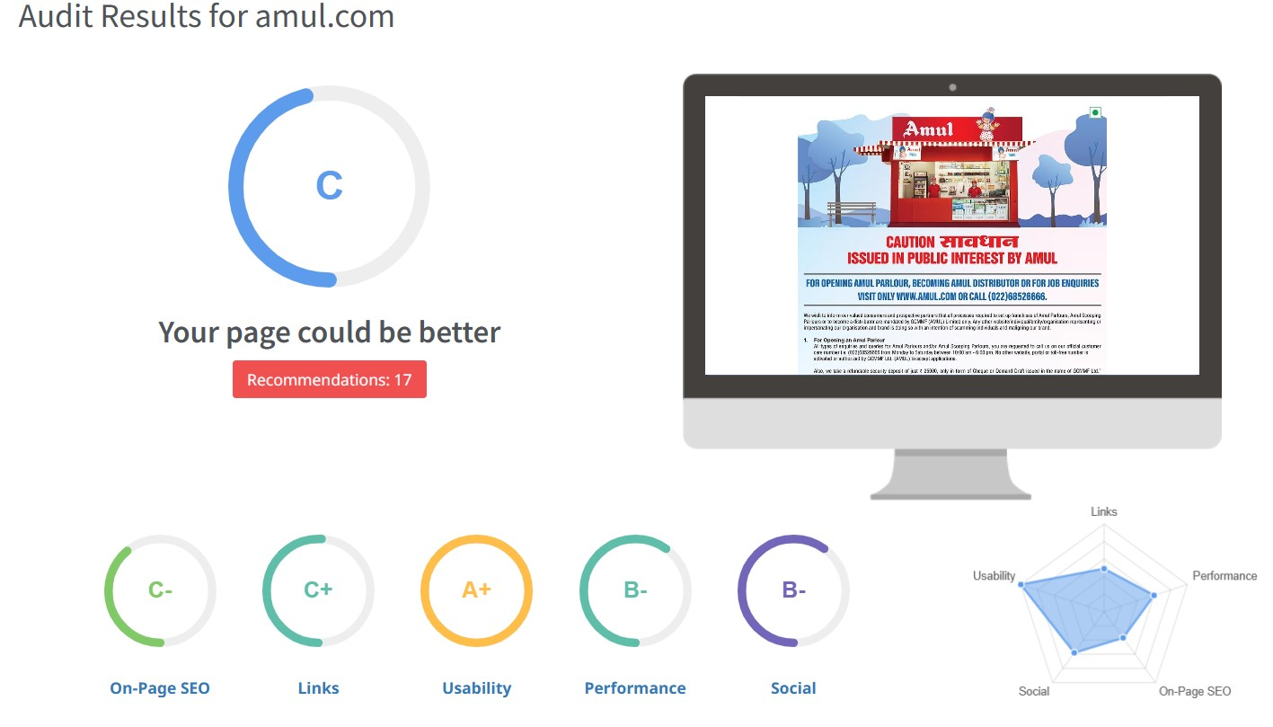
SEO Audit
The website’s SEO score is fair but there’s
room for improvement in building
and tailoring the content for a U.S. audience

Slide 19
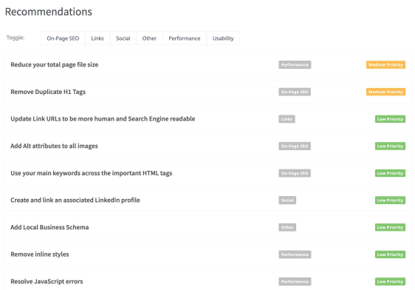
SEO Audit
Enchance image and asset optimization by compressing files,
enchancing load times and user
satisfaction. Remove redundant
H1 tags to streamline content
Structure and enchance search
engine understanding.

Slide 20
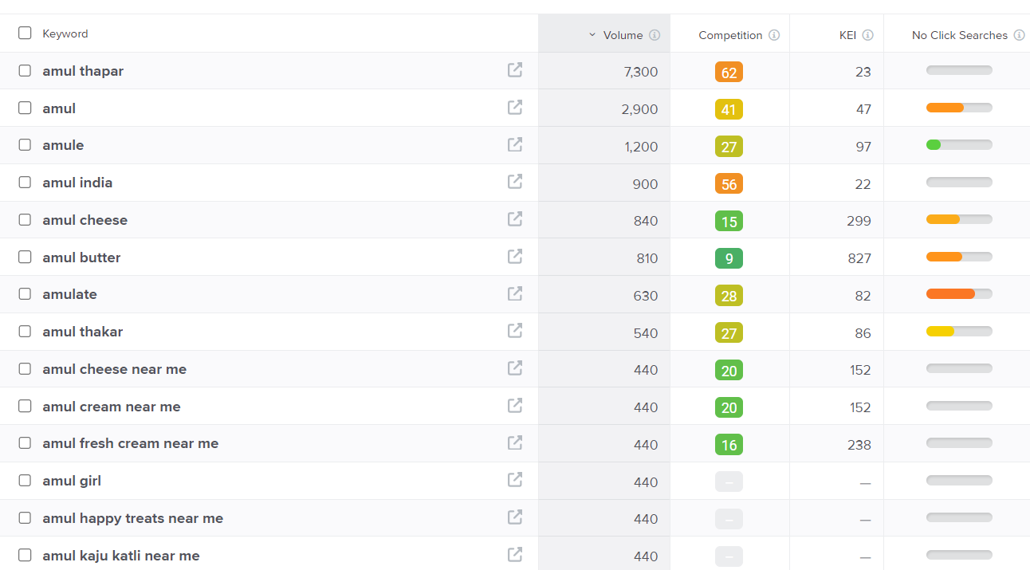
Keyword Research
Keyword Objective: Sale oriented
Amul Fresh Cream
Amul cheese
Amul Butter
Amul Cream
We can use these 4 as primary
Keywords since they have decent
Volumes and are relevant to the
Brands products.

Slide 21
On page Optimization
Focus Keywords: Amul butter, Amul ice cream, Amul milk, Amul franchise…… etc.
Meta Title
“Amul India | Dairy Products, Butter, Ice Cream ,Milk, Cheese & More”
Meta Description
“Discover a wide range of dairy products at Amul India. From creamy butter to delicious ice cream, nutritious milk, and flavorful cheese, explore our quality offering. Learn about our brand history and find Amul products near you”.

Slide 22
On page Optimization (Content Optimization)
Introduction:
What sets Amul apart is its cooperative model, which involves millions of farmers who collectively own and manage the dairy operations. This modal not only empowers farmers but also ensure the freshness and quality of the products. Amul is known for its iconic “Amul girl” advertising campaign, which has been a significant part of Indian pop culture for decades.
Section 1: The cooperative model proved to be a game-changer ,as it brought farmers together to collectively manage the procurement, processing and marketing of milk and dairy product.
Section 2: Training and support Amul not only focuses on milk collection and processing but also provides training and support to farmers. This includes agriculture practices, animal husbandry techniques, quality control measures, and sustainable farming.
Section 3: Amul typically refers to a specific part or aspect of Amul, which is an Indian dairy cooperative known for its milk and dairy products.
Section 4: Could you please provide more context or specify what you’re looking for regarding “Amul Section 4” This will help me provide you with the most relevant information or assistance.
Conclusion: The regarding Amul can vary based on the context or topic being discussed.
Amul’s success as a dairy cooperative is often highlighted, showcasing the power of collective effort and community involvement in the dairy industry.

Slide 23
Document the challenges faced during the research and analysis phase, as well as the key insights gained from the keyword research process.
Getting a free tool to do keyword research is a task since most tools are paid.
We understood how the users search & gained insights into the kind of keywords people search for.
Choosing the right keywords was an issue there were a lot of relevant keywords in the list.

Slide 24
Part 3: Content Ideas and Marketing Strategies
Content Idea Generation & Strategy: Identify your purpose why you want to contact Amul. Is it for a partnership, collaboration, feedback, or another reason? Clarifying your purpose will guide your strategy. Research conduct thorough research, services, recent news, and any ongoing initiatives. This will help you understand their business and how your idea can aligan with their goals.
Mentioned in the calendar.

Slide 25
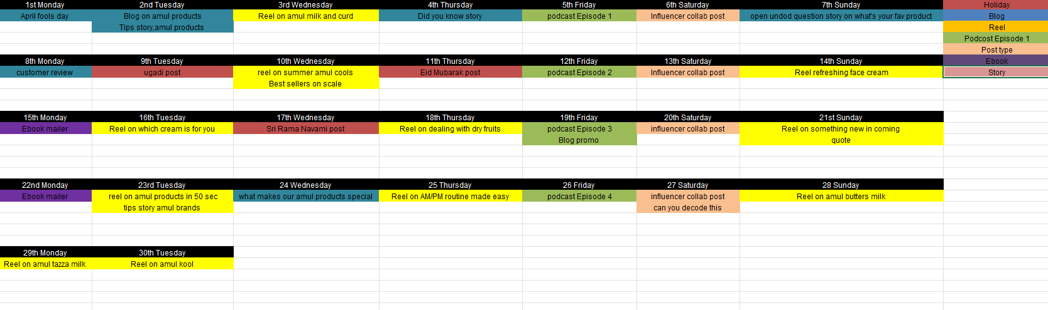
Content Calendar for the month of April 2024

Slide 26
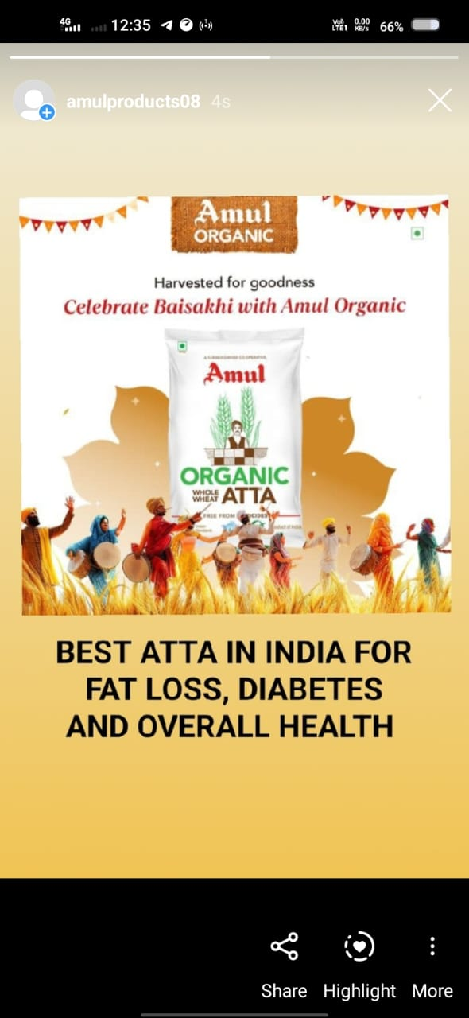
Strategy, Aim and the Idea behind this story
Could you provide more context or details
About the Amul story or strategy you’re referring
To? Knowing a bit more about the
Background or theme would help
Me provide a more accurate response.
The idea is that by having these
Engaging stories such as the format
It would engage follower and
Position the brand as a trusted source of
Amul advice

Slide 27
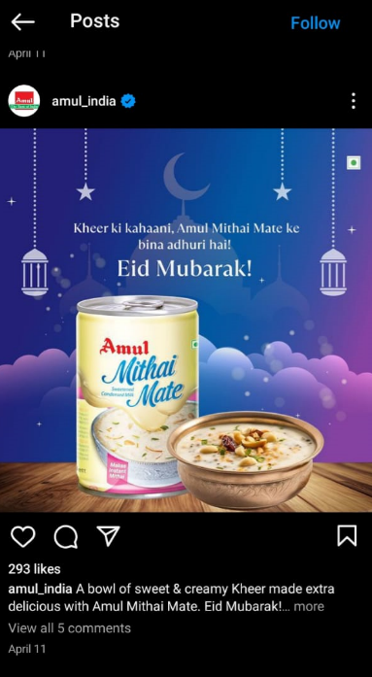
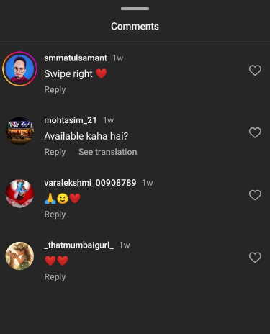
Strategy, Aim and the Idea behind this post
In the grand tapestry of strategies, the Amul aim
Unfurls like a delicate melody, weaving through
The complexities of purpose and vision. The idea
that propels this post transcends mere words;
It seeks to illuminate the path of innovation and insight,
Backonwing us to explore new horizons and unlock
Hidden potentials.
The idea would be to use a simple
Creative to highlight the main USPs

Slide 28
Part 3: Content Ideas and Marketing Strategies
Amul has leveraged various digital marketing channels such as facebook, Instagram and runs influencer marketing and topical marketing campaings.
In the realm of content ideas and marketing strategies for Amul, envision a symphony of creativity and strategic brilliance .picture vibrant narratives celebrating the heritage and quality of Amul products, resonating with warmth and nostalgia. Embrace innovative digital campaigns that connect with audiences on a personal level, fostering loyalty and advocacy. This harmonious blend of storytelling and strategic outreach embodies the essence of Amul’s iconic brand journey.
Digital marketing channel including social media, e mail marketing and influencer collaborations to promote its products and connect with its audience in the digital sphere

Slide 29
PART 4:Content Creation and Curation
Post Creation:
Select Content Categories: The Amul Model of dairy development is a three tiered structure with the dairy cooperative societies at the village level federated under a milk union at the district level and a federation of members unions at the state level.
Format 1: Amul Milk and Curds Post
Format 2: Reel Amul Product Post
Format 3: Birthday Special post

Slide 30
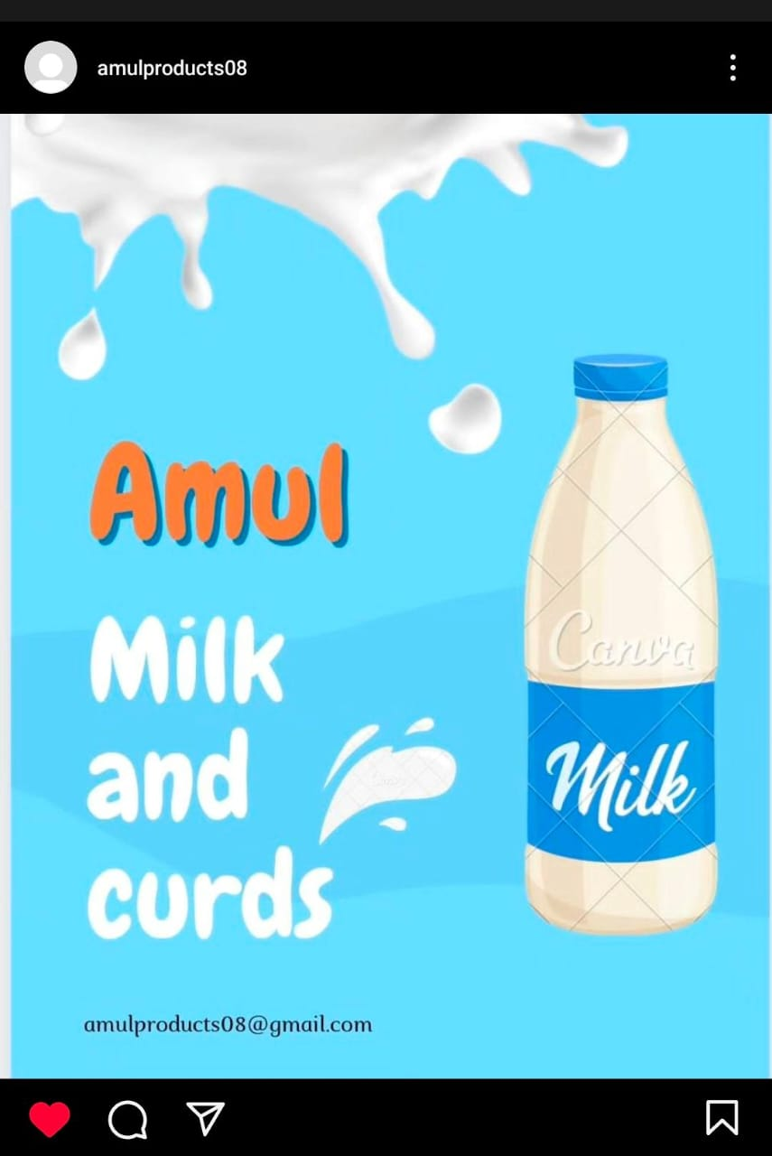
Format 1 : Static Post on Amul Milk and Curd
Caption: You fly you try take it straight higher head higher reaching forward running, jumping, fighting higher milk the world’s original energy drink official sponsor of Indian Olympic team. What would you call Dahi that’s thick, rich, tasty, versatile, and as good as homemade? We called it ‘Massst Dahi’…. Yaane Masti Dhai! Enjoy the Amul Masti Dhai experience!
Link: https://www.instagram.com/p/C59zAUtPVzn/?igsh=MWptOXFxMjc5cnd2bw==
Post:
Hashtags: #AmulMilk #IndianOlympic
#Amulcurd

Slide 31
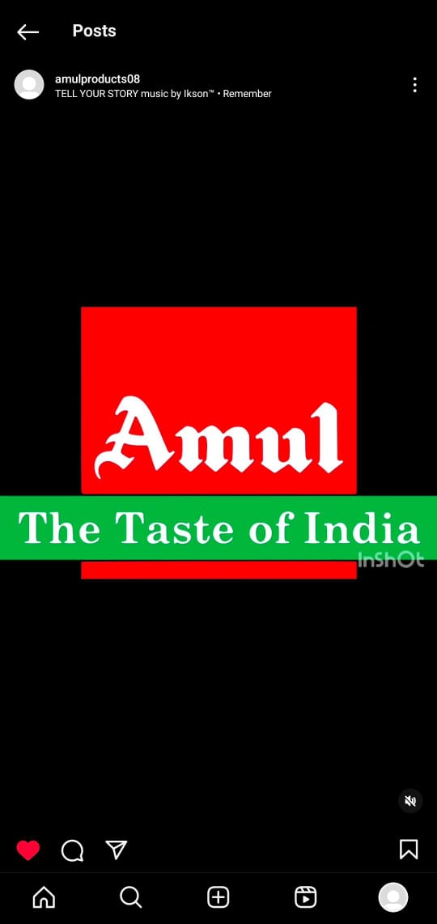
Format 2: Reel post on Amul products
Caption: Raise the bar of love with Amul Dark Chocolate Ice cream, Every day love needs a bit of refreshment to reminisce about the good times, Let’s unite all our cheese flavours at the breakfast table, The natural goodness of Amul Milk, It is probiotic low fat and has no added sugar, Savour the joy of your special vacation traditions with the richness of Amul Fresh Cream incomplete without whipping up magical moves this happy special vacations.
Link: https://www.Instagram.com/reel/C576f89rSKg/?igsh=MWIvY3hpa2FoaGV4Mg==
Reel Post:
Hashtages:
#Amul#Butter#Lassi#Chocolate
#Milk#Dhai#Freshcream#Icecream

Slide 32
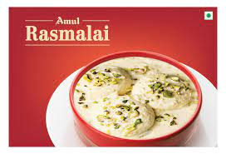
Format 3- Festivals Post on Amul Rasmalai
Caption : Rasmalai is cooking up a storm worldwide with its delicious taste because it has been crowned as the world’s 2nd best cheese dessert by tasteatlas.
Link: https://images.app.goo.gl/EVpPWNdpSjv9yJTj7
Post:
Hashtags:#Rasmalai
#Amul #Sweet#Mithai#Amulmithai#Amulsweets

Slide 33
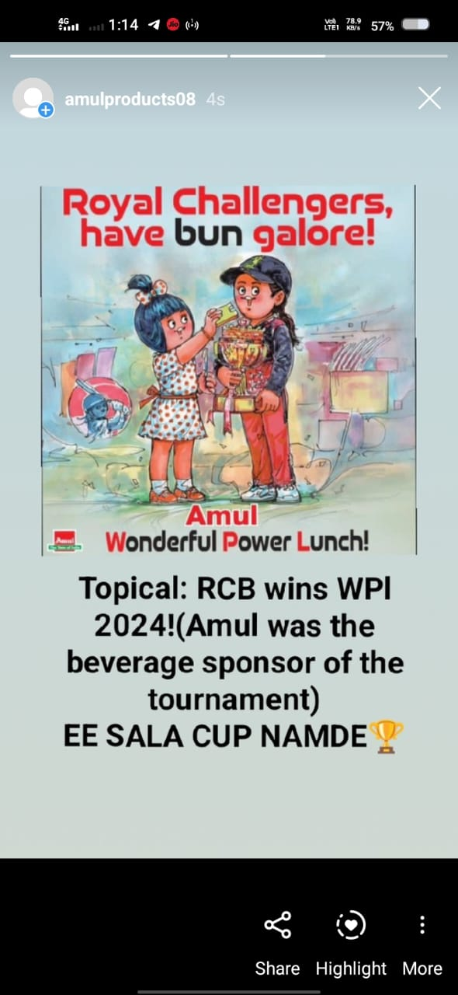
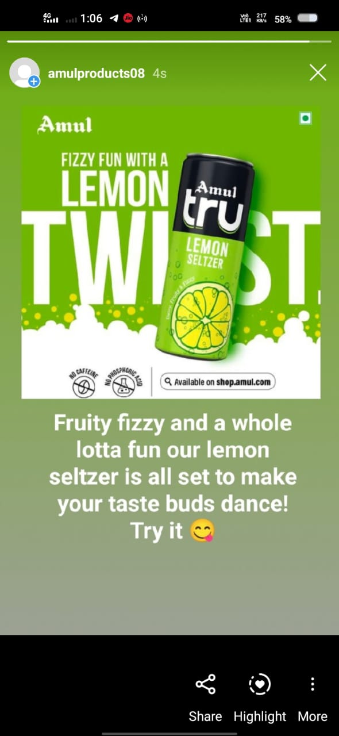
Instagram Story
Screenshots of story.
https://www.instagram.com/stories/amulproducts08/3351679519180792258?utm_source=ig_story_item_share&igsh=NTc4MTIwNjQ2YQ==

Slide 34
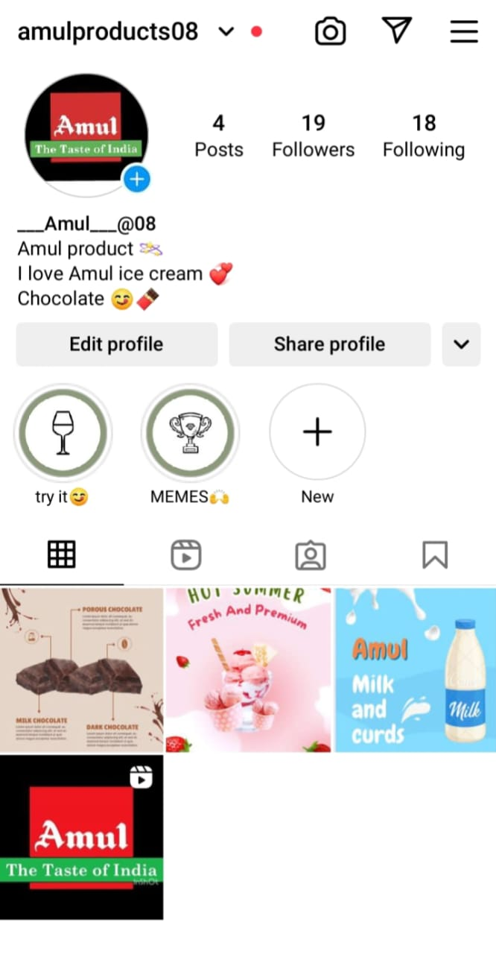
Highlights for Story.
https://www.instagram.com/s/aGlnaGxpZ2h0OjE4MDY5MDY4ODM2NTAwNjg5?story_media_id=3351679519180792258&igsh=NTc4MTIwNjQ2YQ==

Slide 35
Story Insights – Q&A
Reach is 560
Impressions is 670
Like is 370
Etc….
Area for improvement:
In the subsequent years Amul made cheese and baby food on a large commercial scale again processing buffalo milk creating a history in the world.
Since the shares of Amul’s journey from a small cooperative to a global brand is a remarkable tale of resilience, innovation, and social impact.

Slide 36
Part 4: Content Creation and Editing Designs/Video Editing
Design Tools Familiarization(use canva for creating visually appearing graphics)
Video Creation: Utilize VN or any video editor of your choice to create videos related to the choose we Inshot video app we created.

Slide 37
THANK YOU
Presented By
P. Keerthi
P. Karthik Surya
P. Anil Kumar
P. Anusha
P. Thanuja

